Slide 1

Good morning !
Welcome to ....

Slide 2




ALPINE ASCENTS
VIETNAM
Website Development
C2312L
Alpine Ascents Viet Nam

Slide 3






Members
Nguyễn Văn Hiếu
Lưu Minh Quân
Nguyễn Văn Hậu
Nguyễn Đức Mạnh

Slide 4




General Introduction
Alpine Ascents Vietnam was created to offer unique adventure travel experiences at famous destinations in Vietnam.
As adventure tourism grows, the website helps customers find and book tours while providing useful information.

Slide 5
Functions
Users
Customer Account
Admin Management
Tour
Gallery
Index
Admin Management
Index
Admin Management
Branch
Order
Admin Management
Index
Admin Management
Order Form
Information
Index

Slide 6
USER
Customers
Administrator

Slide 7
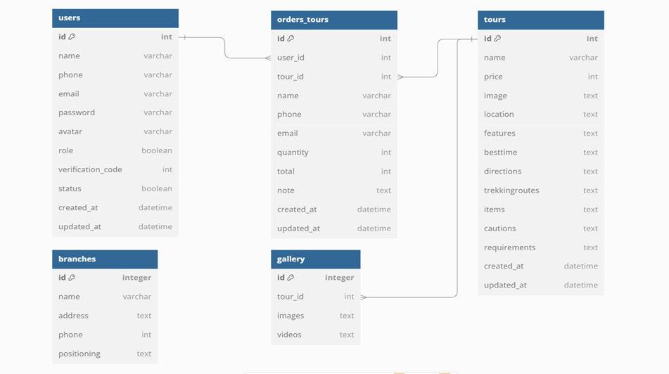
Entity Relationship Diagram

Slide 8
Database Design
Users Table | Tours Table | Orders Table | Branches Table | Galleries Table
id name phone email password avatar role verification_code status timestamps | id name price image location features besttime directions trekkingroutes items cautions requirements timestamps | id user_id tour_id name phone email quantity total note timestamps | id name address phone positioning timestamps | id tours_id images videos timestamps

Slide 9
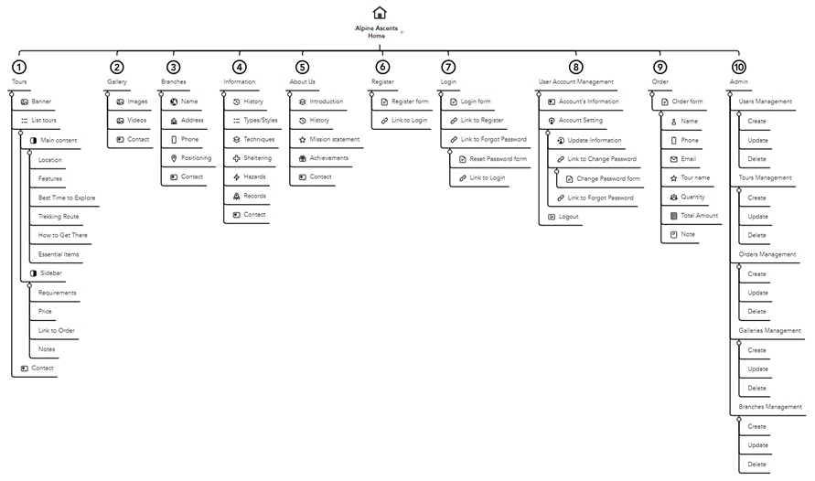
-- Sitemap --

Slide 10
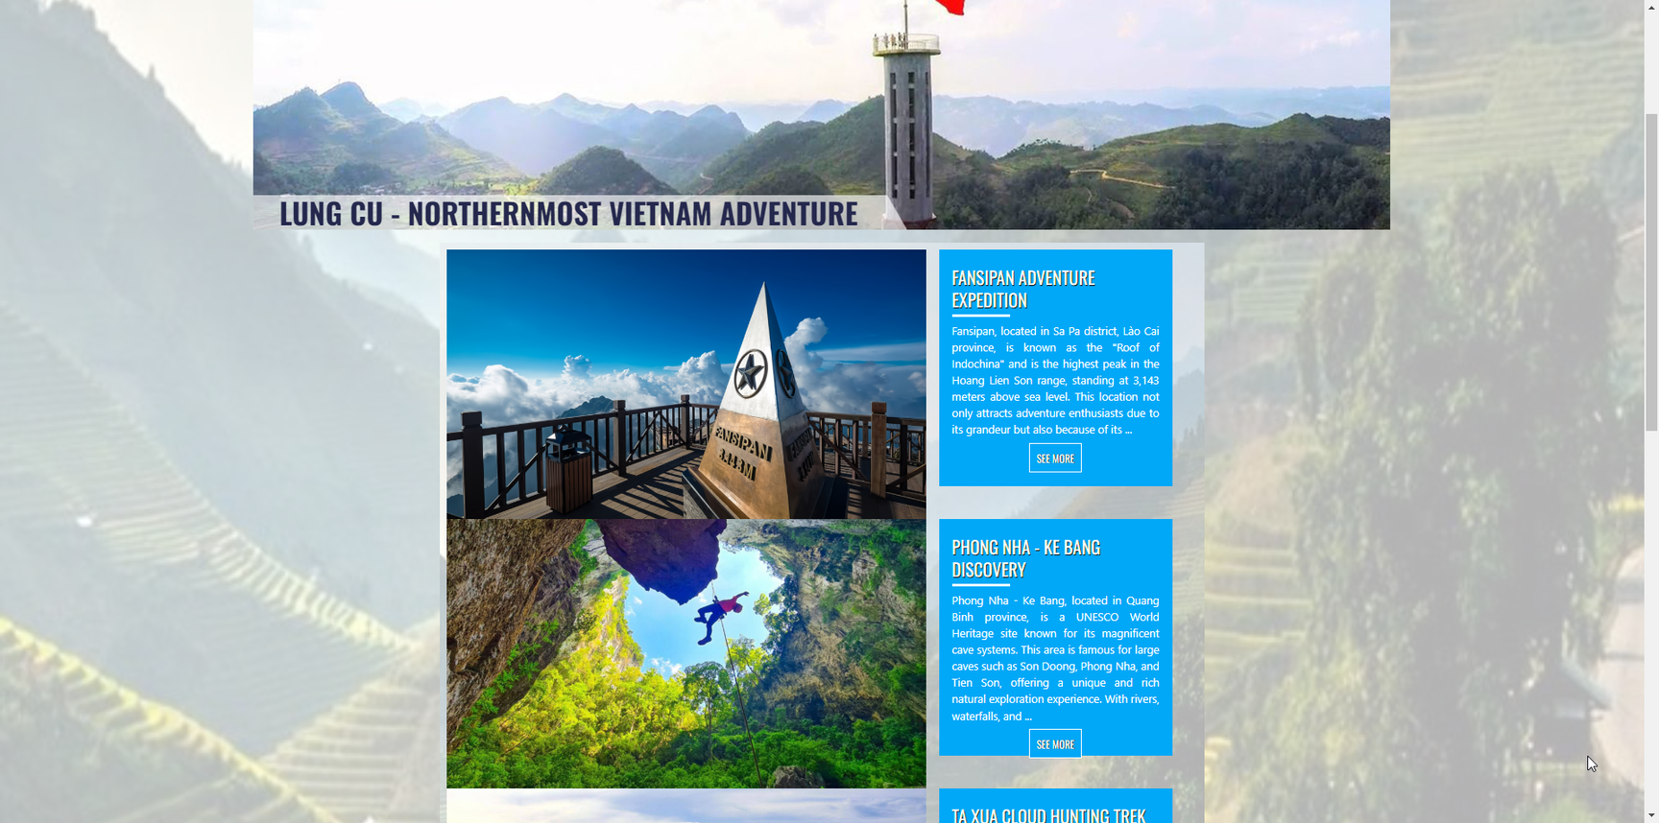
Function Tours Index
View Tours list
Tour Information
Images and video
Order Tour

Slide 11
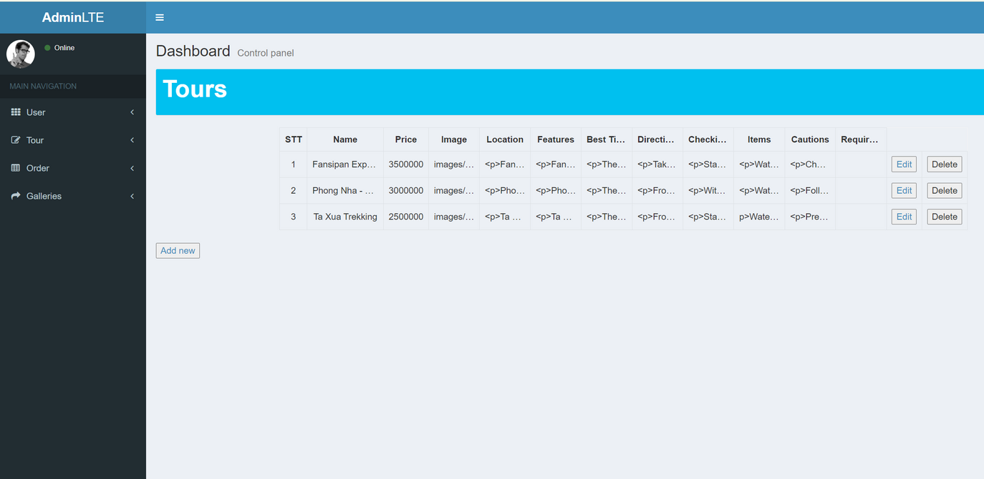
Admin Tour Management
View detailed information for each tour
View Tours list
Add new tour
Edit Tour
Delete tour

Slide 12
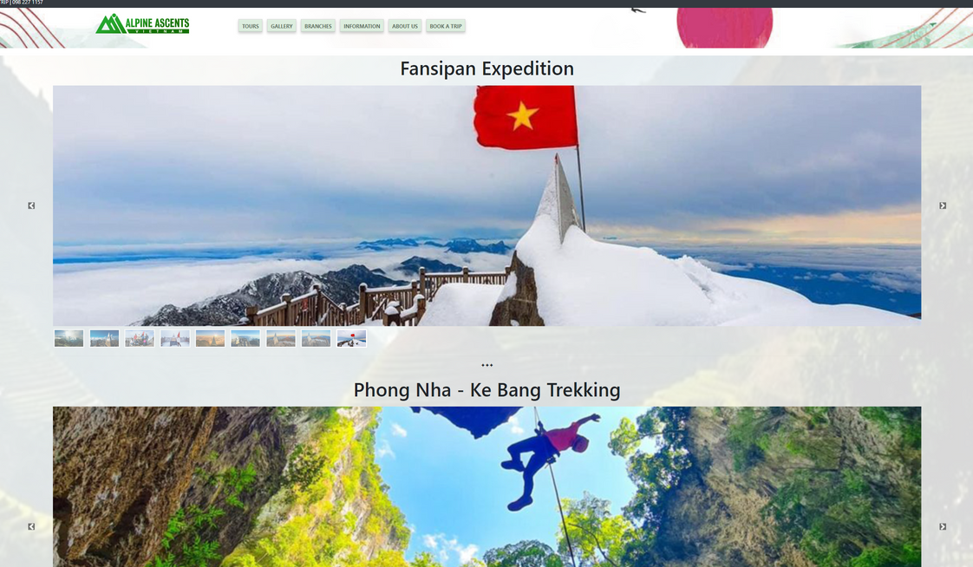
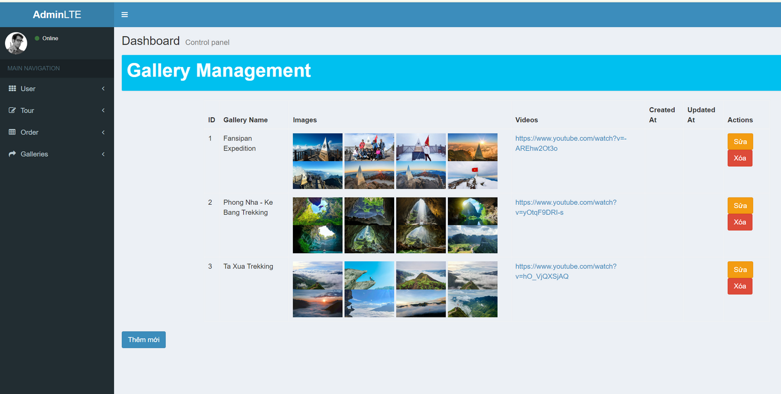
Function : Gallery
Show images and videos
Display slideshow / carousel
Gallery for Admin
View all Images and Videos
Add new / Edit gallery
Delete Image / video

Slide 13
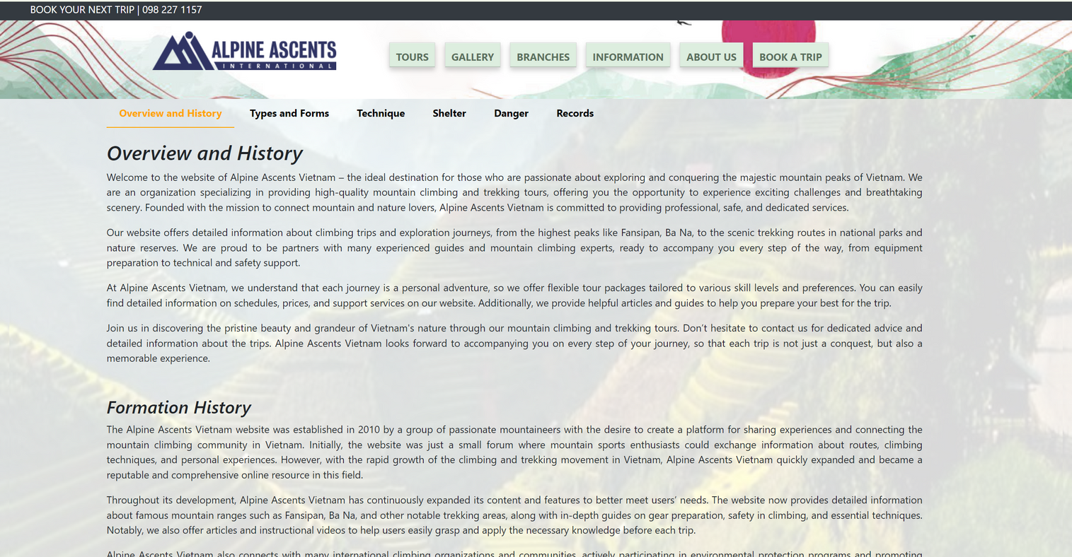
Function Information
Display essential information about the climbing process.
Show website history, types of climbing, techniques, v.v...

Slide 14
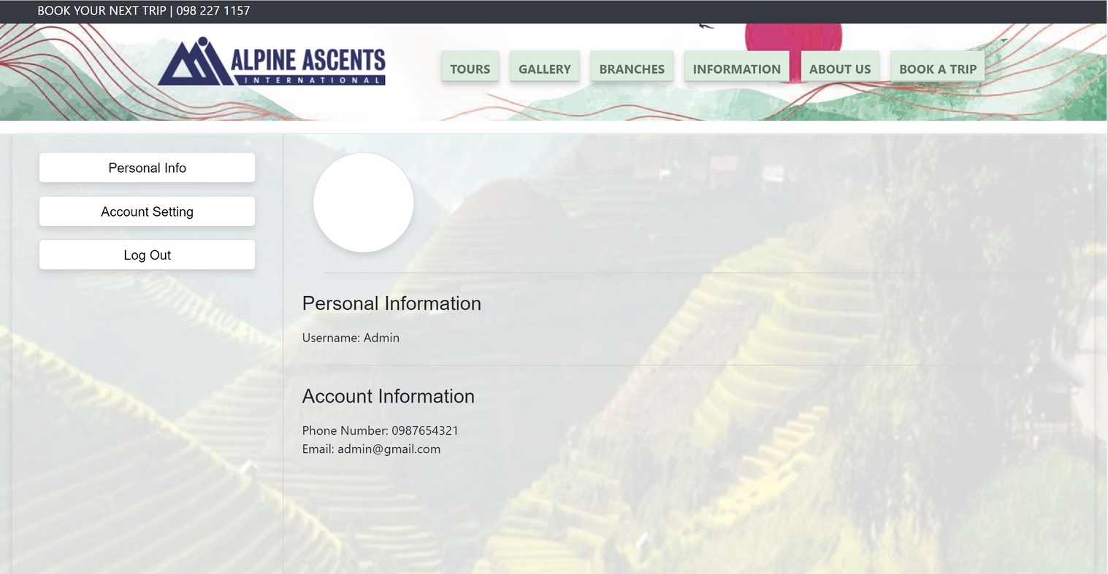
Account Management for Customer
Register new account
View and edit
their own
information
Forget password
+ change Password

Slide 15
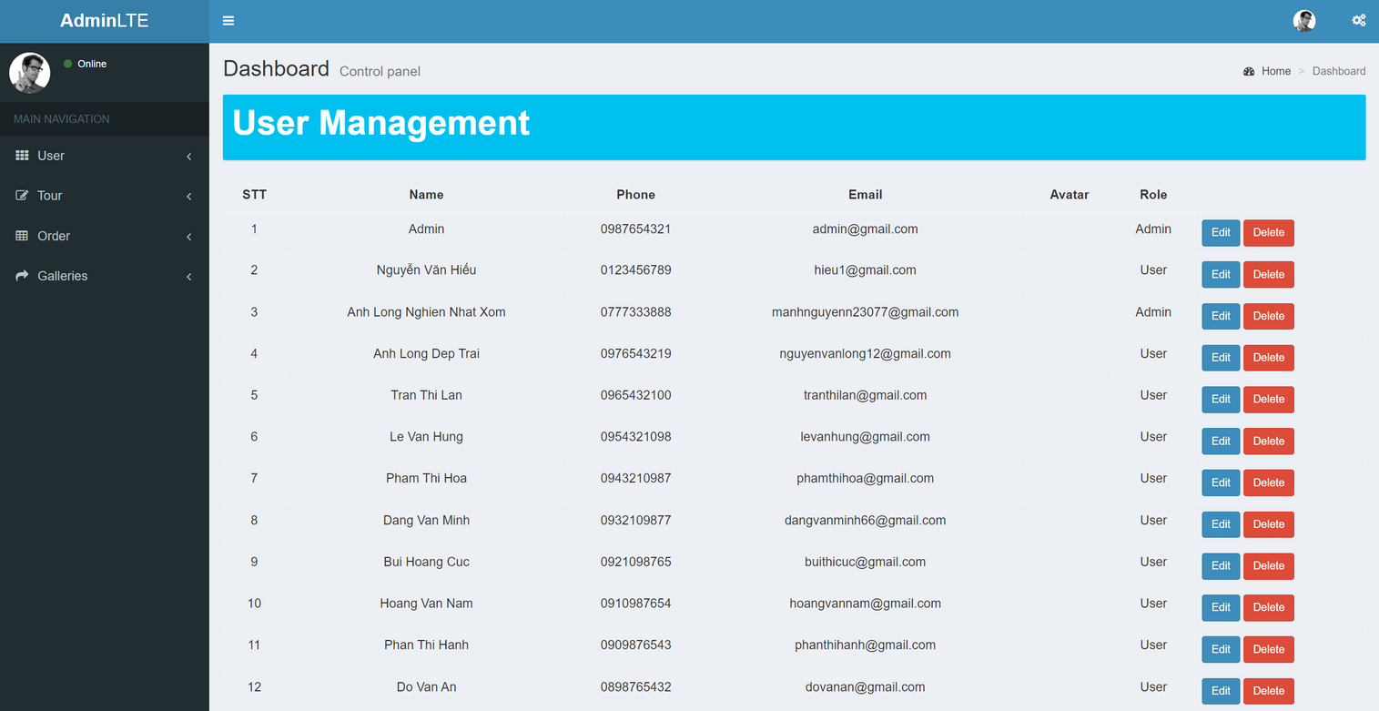
User Management
for Admin
Show all users and account info
Add new, edit or
Delete user
Promote user to
administrator

Slide 16
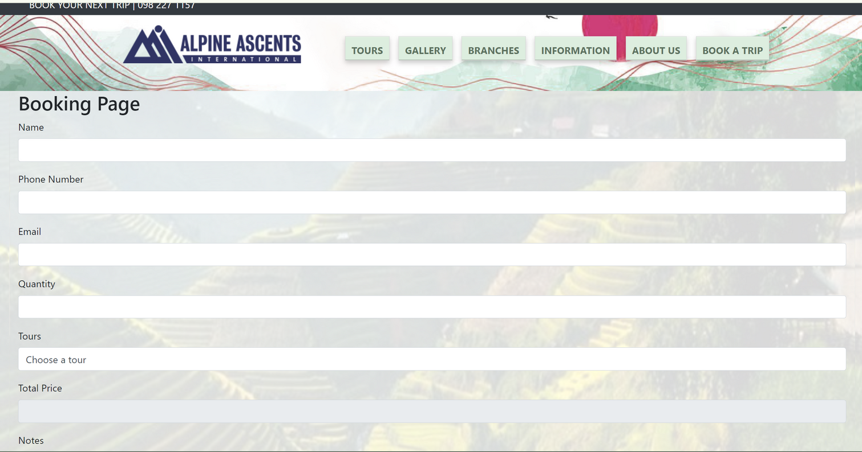
Tour Order
for Users
Allow users to enter information for
booking a tour.
Return the order result and display a success or error message.

Slide 17
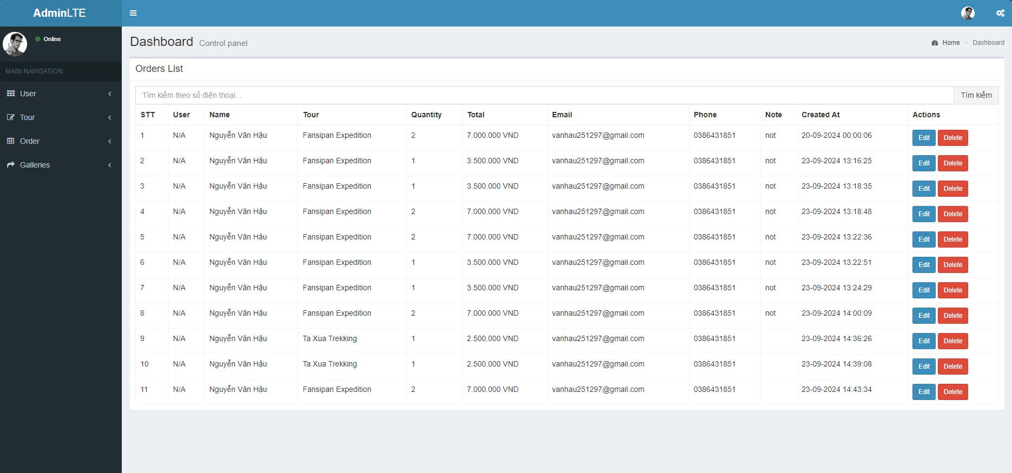
Admin Orders
Management
Allow users to enter information for
booking a tour.
Return the order result and display a success or error message.

Slide 18
Boundaries of the System
No Online Payment
No Shopping Cart Feature
No Order Status Management
No Multilingual Support
No Advanced Security Feature
and more.......

Slide 19
And with that, our presentation comes to an end.
Thank you for your time !

